Slide 1
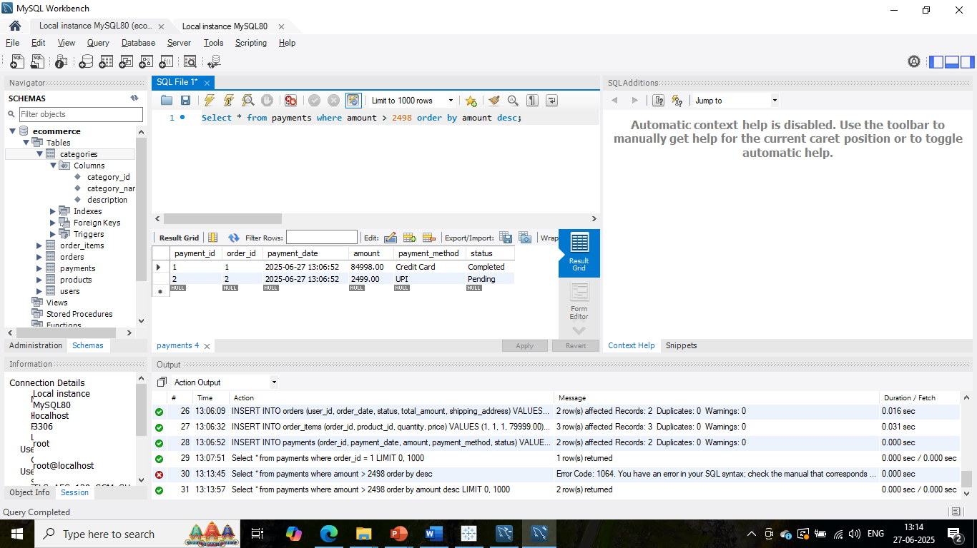
1) Select query with order by and Where condition

Slide 2
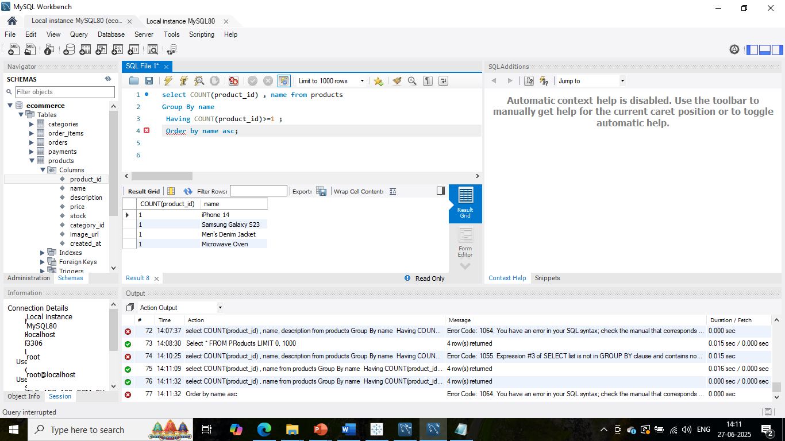
2) Select query with order by, Group by, Having and Where condition

Slide 3
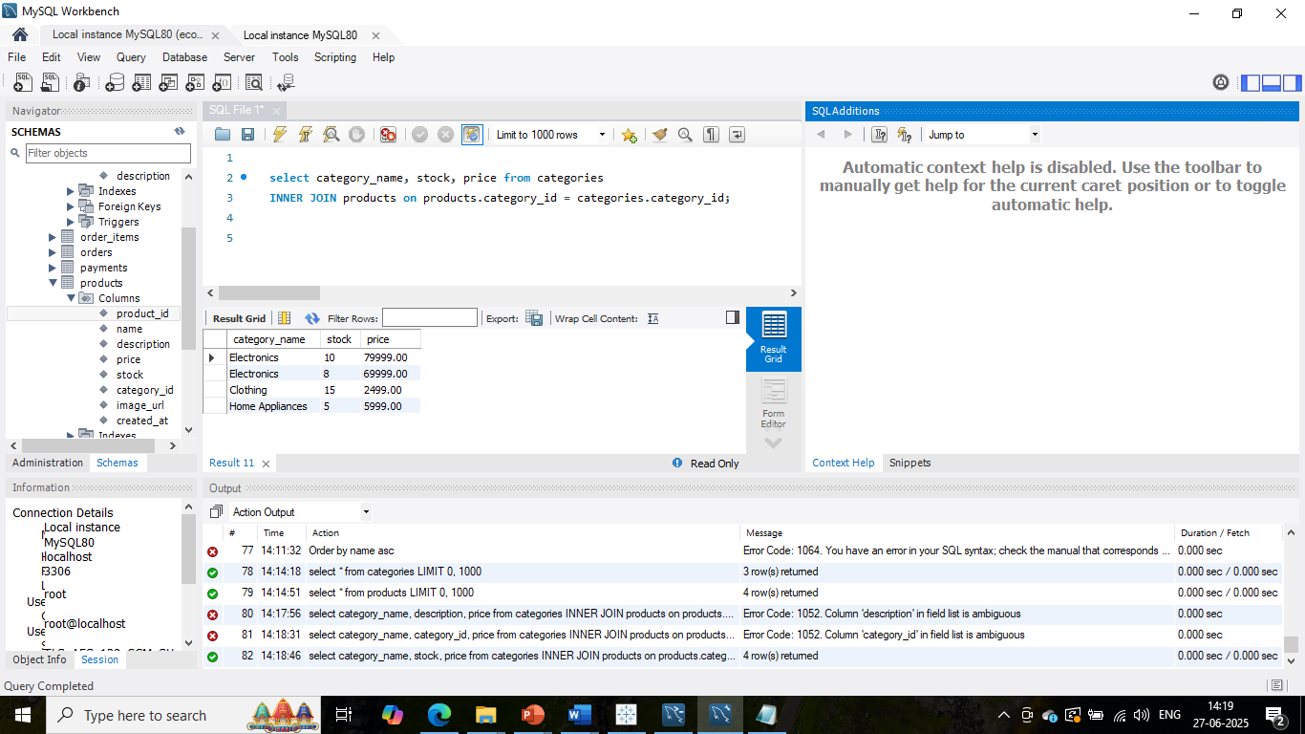
3) Inner join

Slide 4
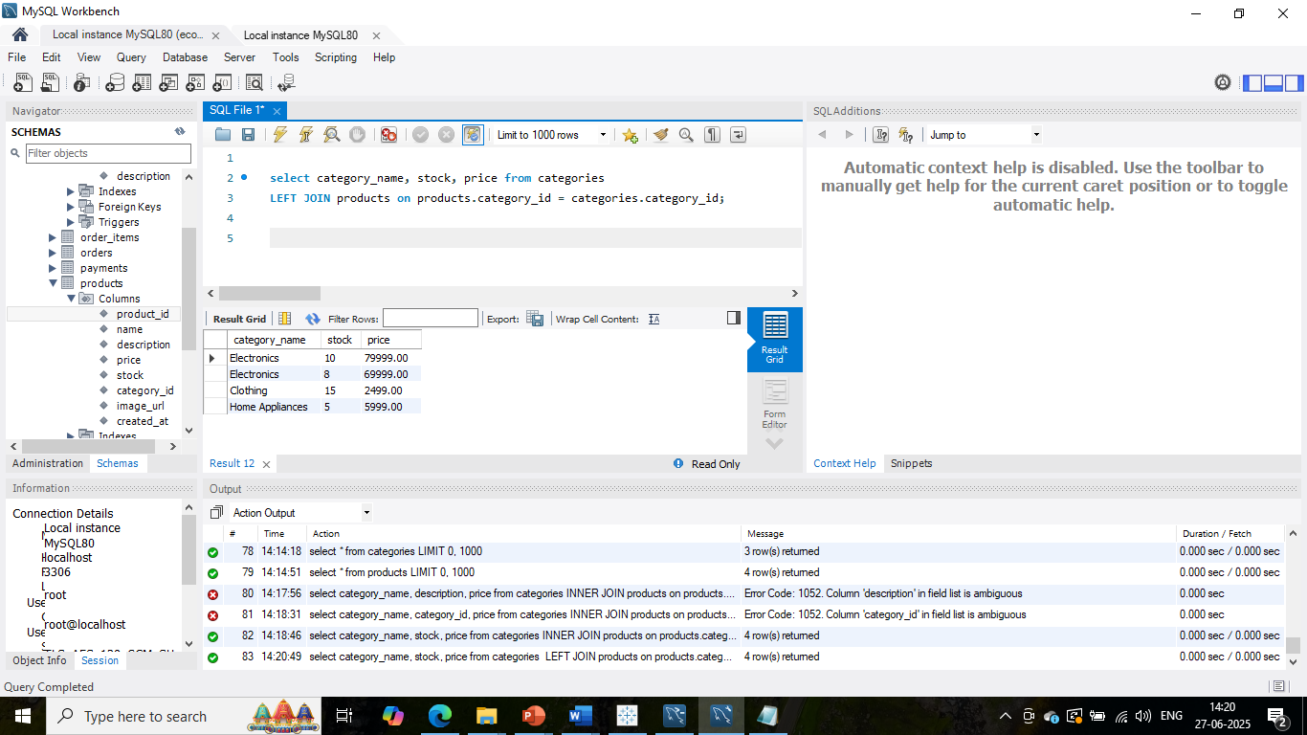
4)Left join

Slide 5
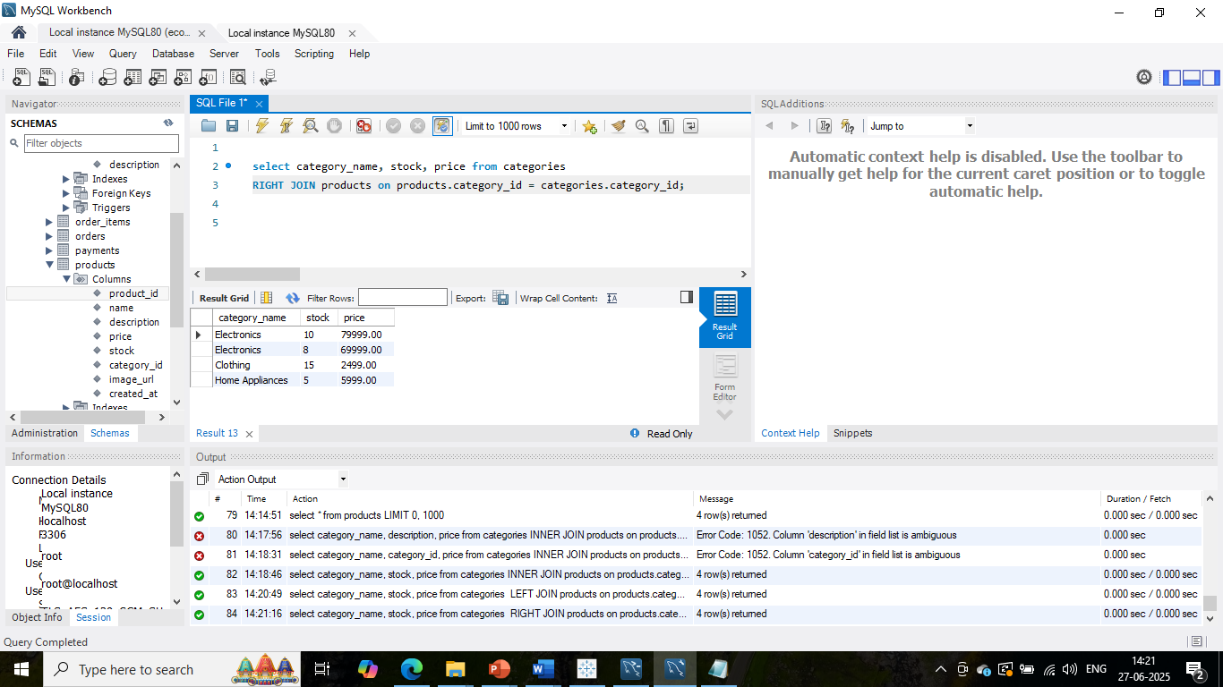
5)Right join

Slide 6
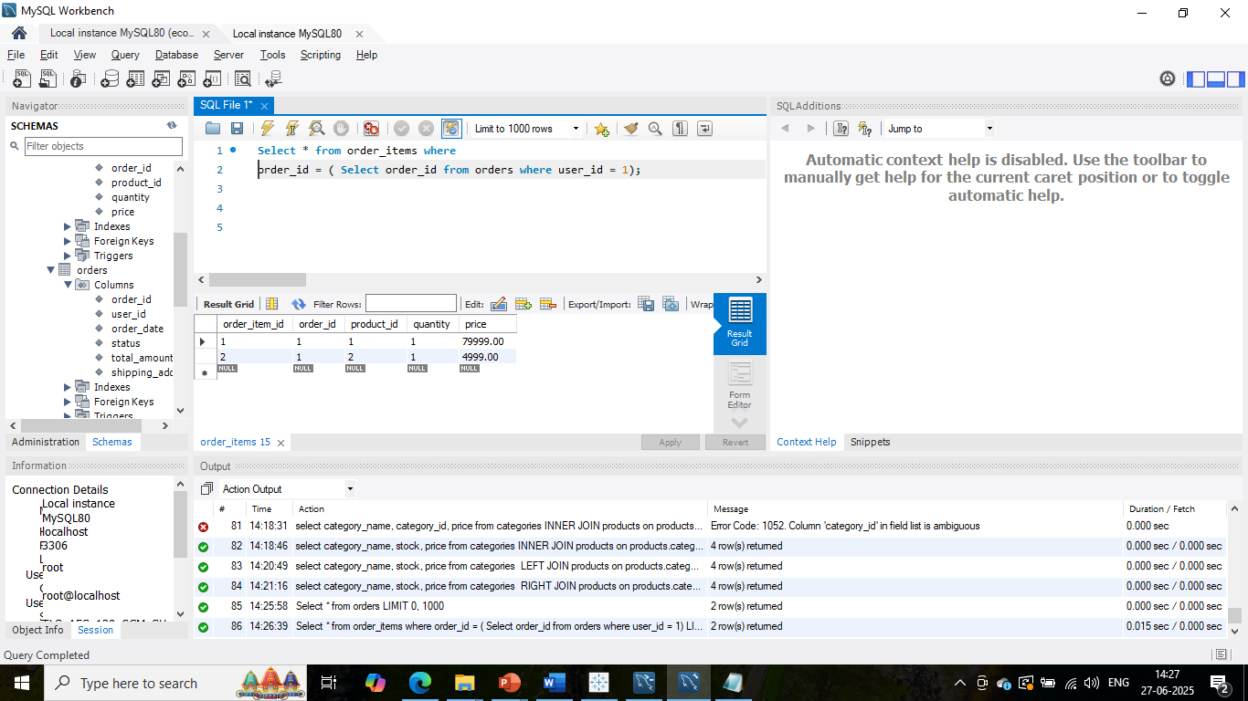
6)Subquery

Slide 7
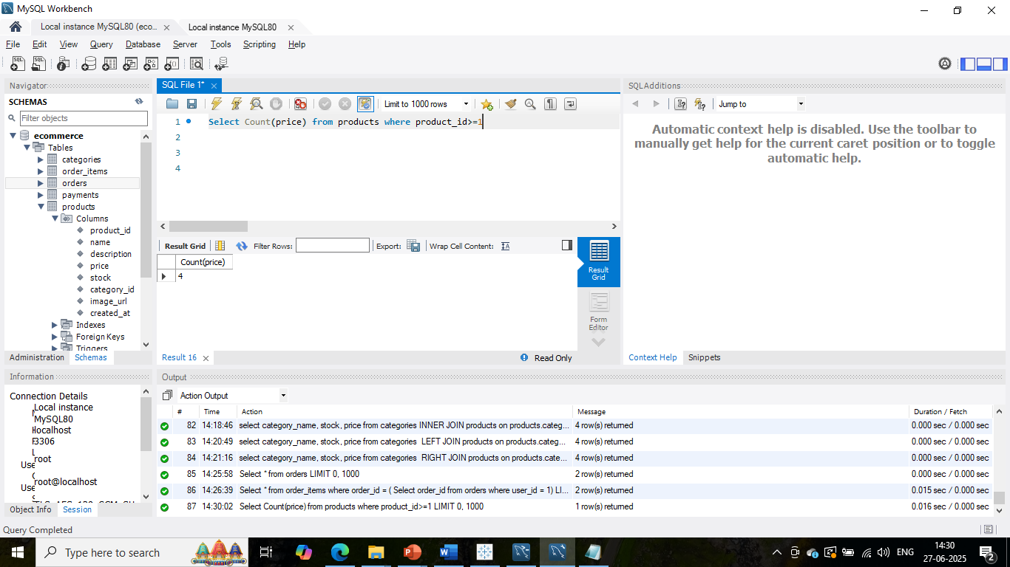
7)Aggregate function = count

Slide 8
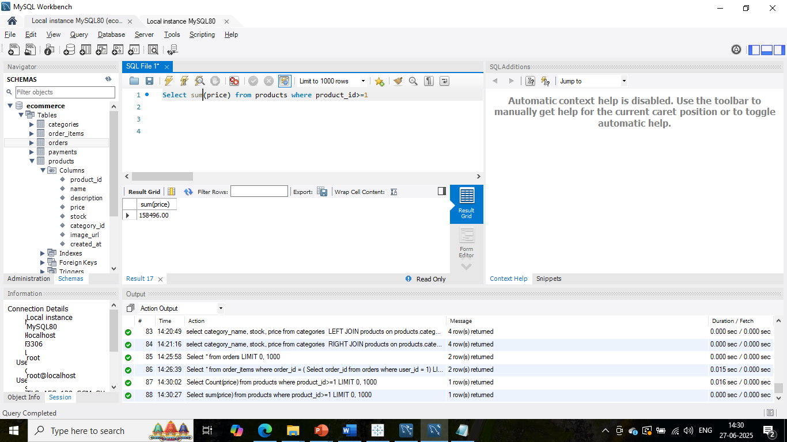
8)Aggregate function = sum

Slide 9

9)Aggregate function = Avg

Slide 10
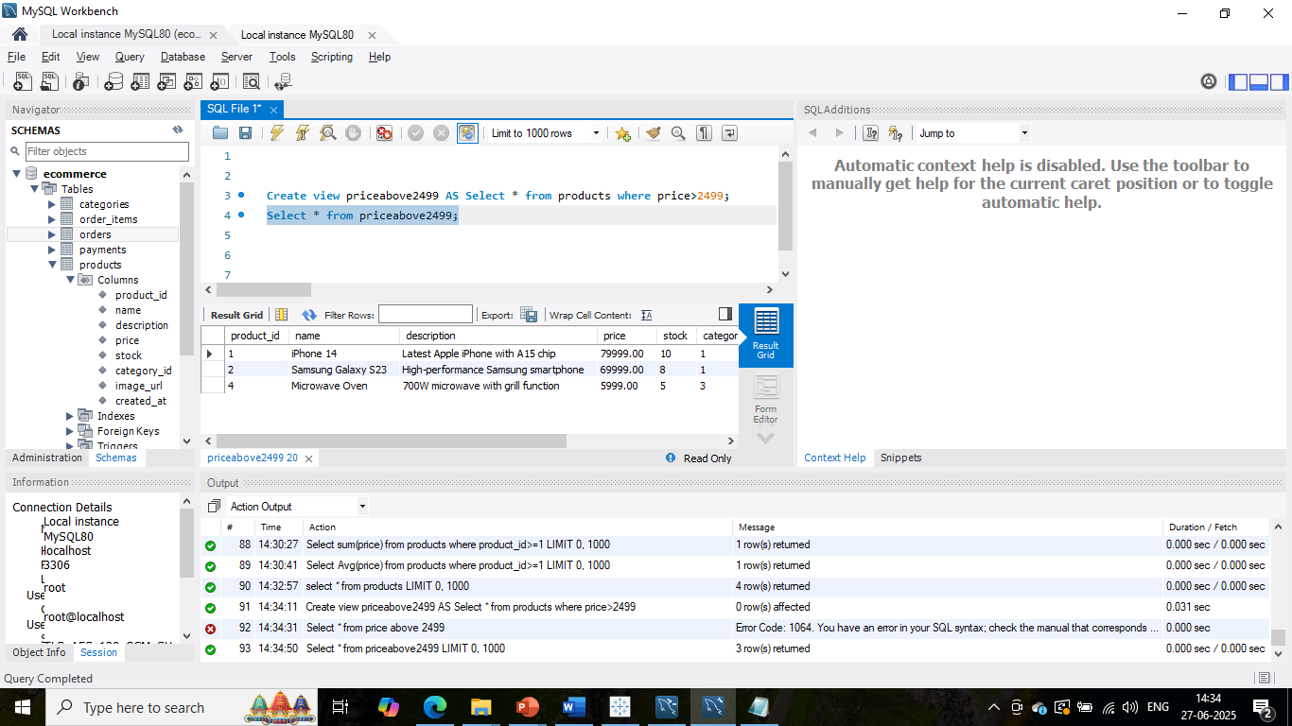
10)Create and execute of view

Slide 11
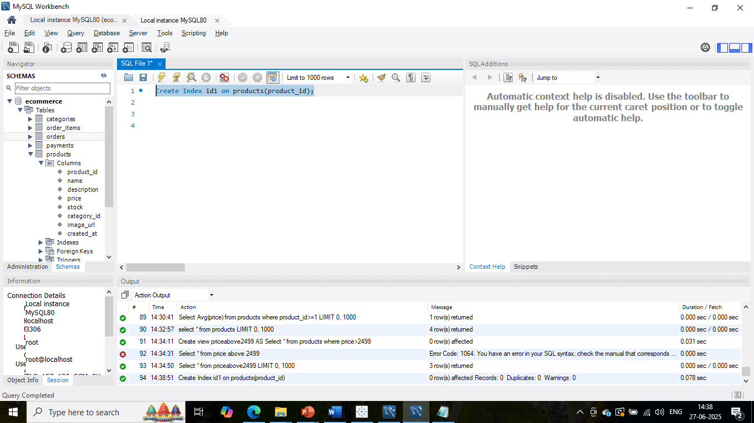
11)Create Index

